Slide 1
Day 3
R
Stand Up meeting 9:15-9:30
Decisions:
  Development starts, decision to use the implemented solution ”Beer Store” in earlier lab as a starting point.
  Each member get a separate part to deliver (one page of the solution)
A lot of problems with GIThub, to be continued…

Slide 2
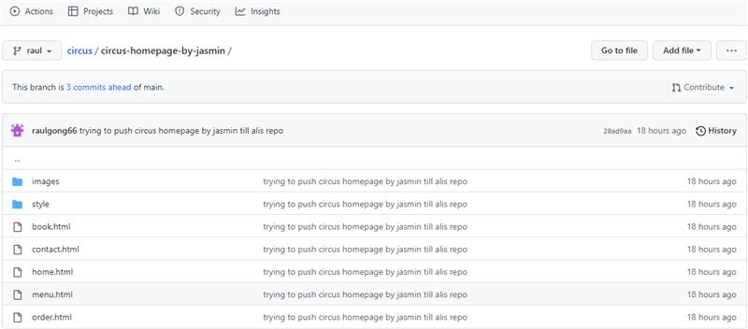
GIThub
R

Slide 3
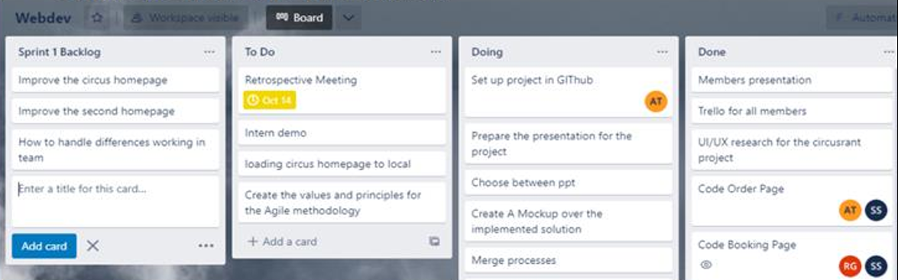
Day 4
R
Stand Up meeting 9:15-9:30
Development continues
Decisions:
  Start the work of deliver a Presentation
  Ali suggested alternative implementation
    Decision: Ali to present it on Friday 10:00 for further discussion

Slide 4

Preparing Presentation
R
Circus Restaurant

Slide 5
Preparing Presentation
R
Circus Restaurant

Slide 6
Day 5
R
Stand Up meeting 9:15-9:30
Decisions:
Ali's second homepage presentation (see next slide)
Sprint Review
To close the code development at 14:00 Friday
By Friday afternoon
  Demo of presentation
Project closed by 17:00 Friday

Slide 7
Meeting: Ali’s alternative implementation
R
Notes from meeting at 10:00.
A meeting is hold to discus Ali’s suggested alternative implementation. Ali demonstrate a different solution.
Decision: The group likes Ali’s suggestion; it gives a greet feeling to the web site but decide not to incorporate it, given the short time left in the project.

Slide 8

What is the best agile way of working?
Agile working is about bringing people, processes,
connectivity and technology, time and place together to
find the most appropriate and effective way of working to
carry out a particular task.
It is working within guidelines (of the task) but without
boundaries (of how you achieve it).

